Slide 1
Google Play Review Sentiment and App Success
Group 10
Alyssa Lopez, Pranay Bhaskar Mallipudi, Shailendra Narwaria, Kelsey Towfiq

Slide 2
Business Problem
Google play store apps are typically accompanied by user reviews sorted from most to least helpful. Prospective users make the decision to install apps for a variety of reasons, and in this study we seek to uncover the relationship between review sentiment and installation rate.
“How much influence does review sentiment have on overall installs?”
Notes:
In this study, we were interested in uncovering factors that influence app success. Specifically, we are interested in the relationship between app review sentiment on the # of app installs, which is serves as a proxy for app success. We will answer the question: How much influence does review sentiment on overall installs.

Slide 3
Value of Data-Driven Approach
Analyzing Google play app to:
Uncover user trends
Identify areas of product strength and weaknesses
Gain better understanding of the cause and effect in app installation rates.
Considerations:
Paid or promoted versus organic reviews
Need versus want
Notes:
Traditionally, CEOs have been known to rely on their intuition when making decisions on their companies and products. However, as analytics has proven over the years, often times analytics can uncover results that can optimize a company’s business decisions in ways that intuition may be not be able to identify.

Slide 4
Ideal Experiment: Randomized Control Study
Randomize Assignment
Experimental Groups
Study Procedures
Present each subject the app category, description and 100 “most helpful” reviews as subset for each experimental group. Ask: “Would you install this app?”
positively skewed
balanced
negatively skewed

Slide 5
Hypotheses
Hypothesis 1
H₀: | There is no relationship between review sentiment and number of app installs
H_{A}: | There is a relationship between review sentiment and number of app installs
Hypothesis 2
H₀: | There is no relationship between app category on the number of app installs
H_{A}: | There is a relationship between app category on the number of app installs
Our hypotheses will be tested at alpha = 0.05

Slide 6
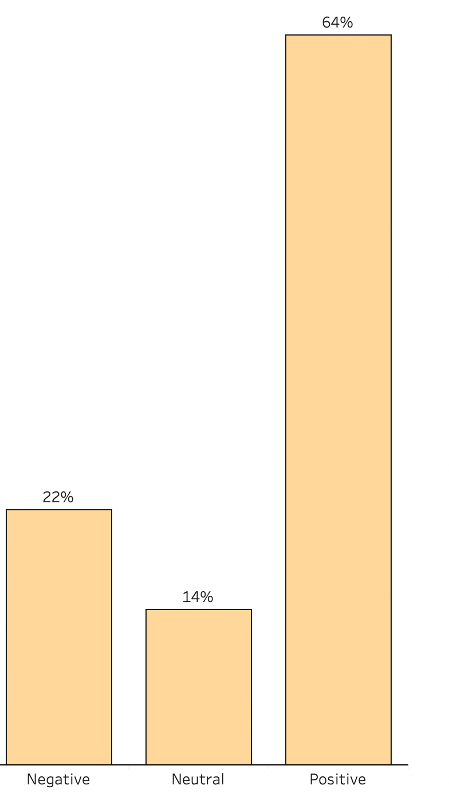
Data
Sources: https://www.kaggle.com/lava18/google-play-store-apps?select=googleplaystore.csv https://www.kaggle.com/lava18/google-play-store-apps?select=googleplaystore_user_reviews.csv
User scraped the data from google play store
Dataset 1: Contains information about 9660 unique apps about their category, size, #installs, #reviews, genre, price among other measures
Dataset 2: Sentiment scores for 1074 apps based on user reviews
Imbalanced dataset with 64% positive reviews, 22% Negative reviews and with 14% neutral ratings
Notes:
Where did you obtain your data?
Are you using multiple data sets? If yes, how are you combining the data?
What is the aggregation level of your data?
What does each row of data represent?
What is the outcome variable(s) that you are interested in?

Slide 7
Data Pre-Processing
Original Dataset
Unique apps = 9660
Merged Dataset
Unique apps = 1074
Final Dataset
Unique apps = 487
Notes:
Merged datasets and subset apps that have reviews and sentiment scores. Remaining apps = 966 Excluded X apps that had less than 15 reviews → Remaining apps = 487

Slide 8
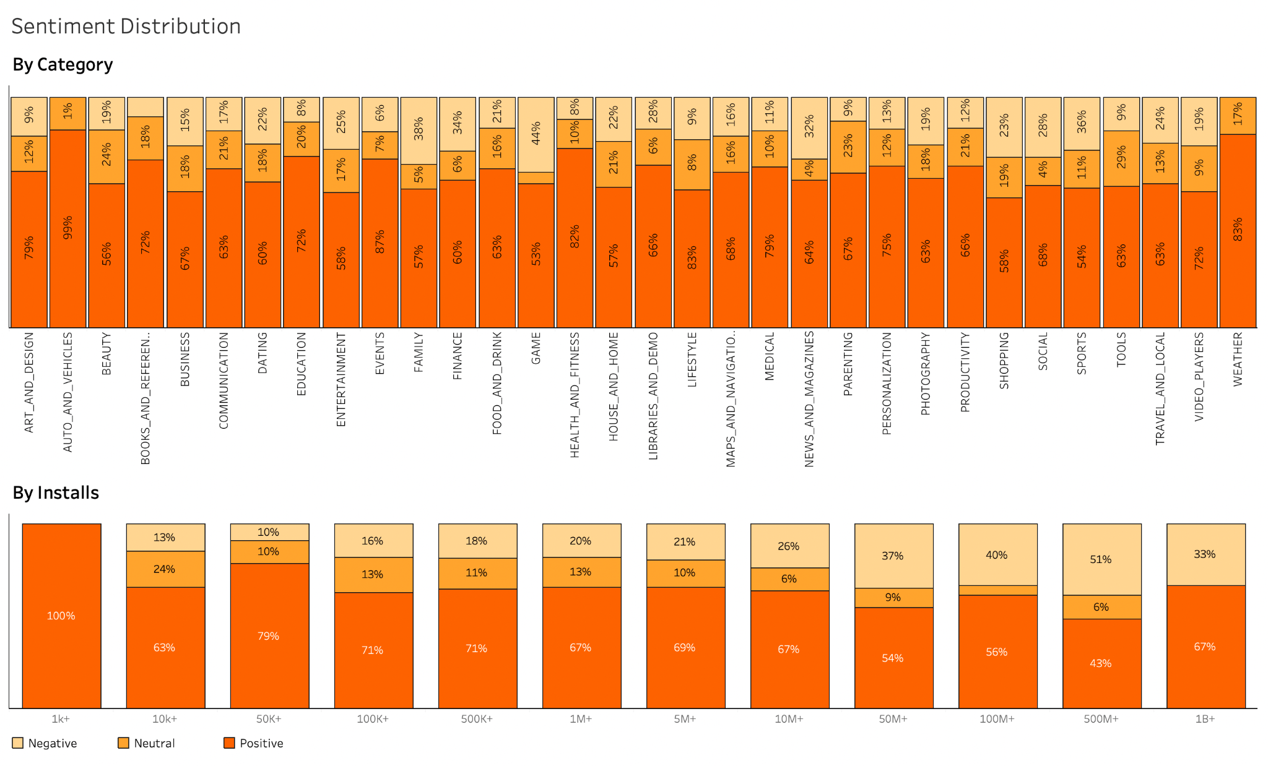
Exploratory Data Analysis

Slide 9
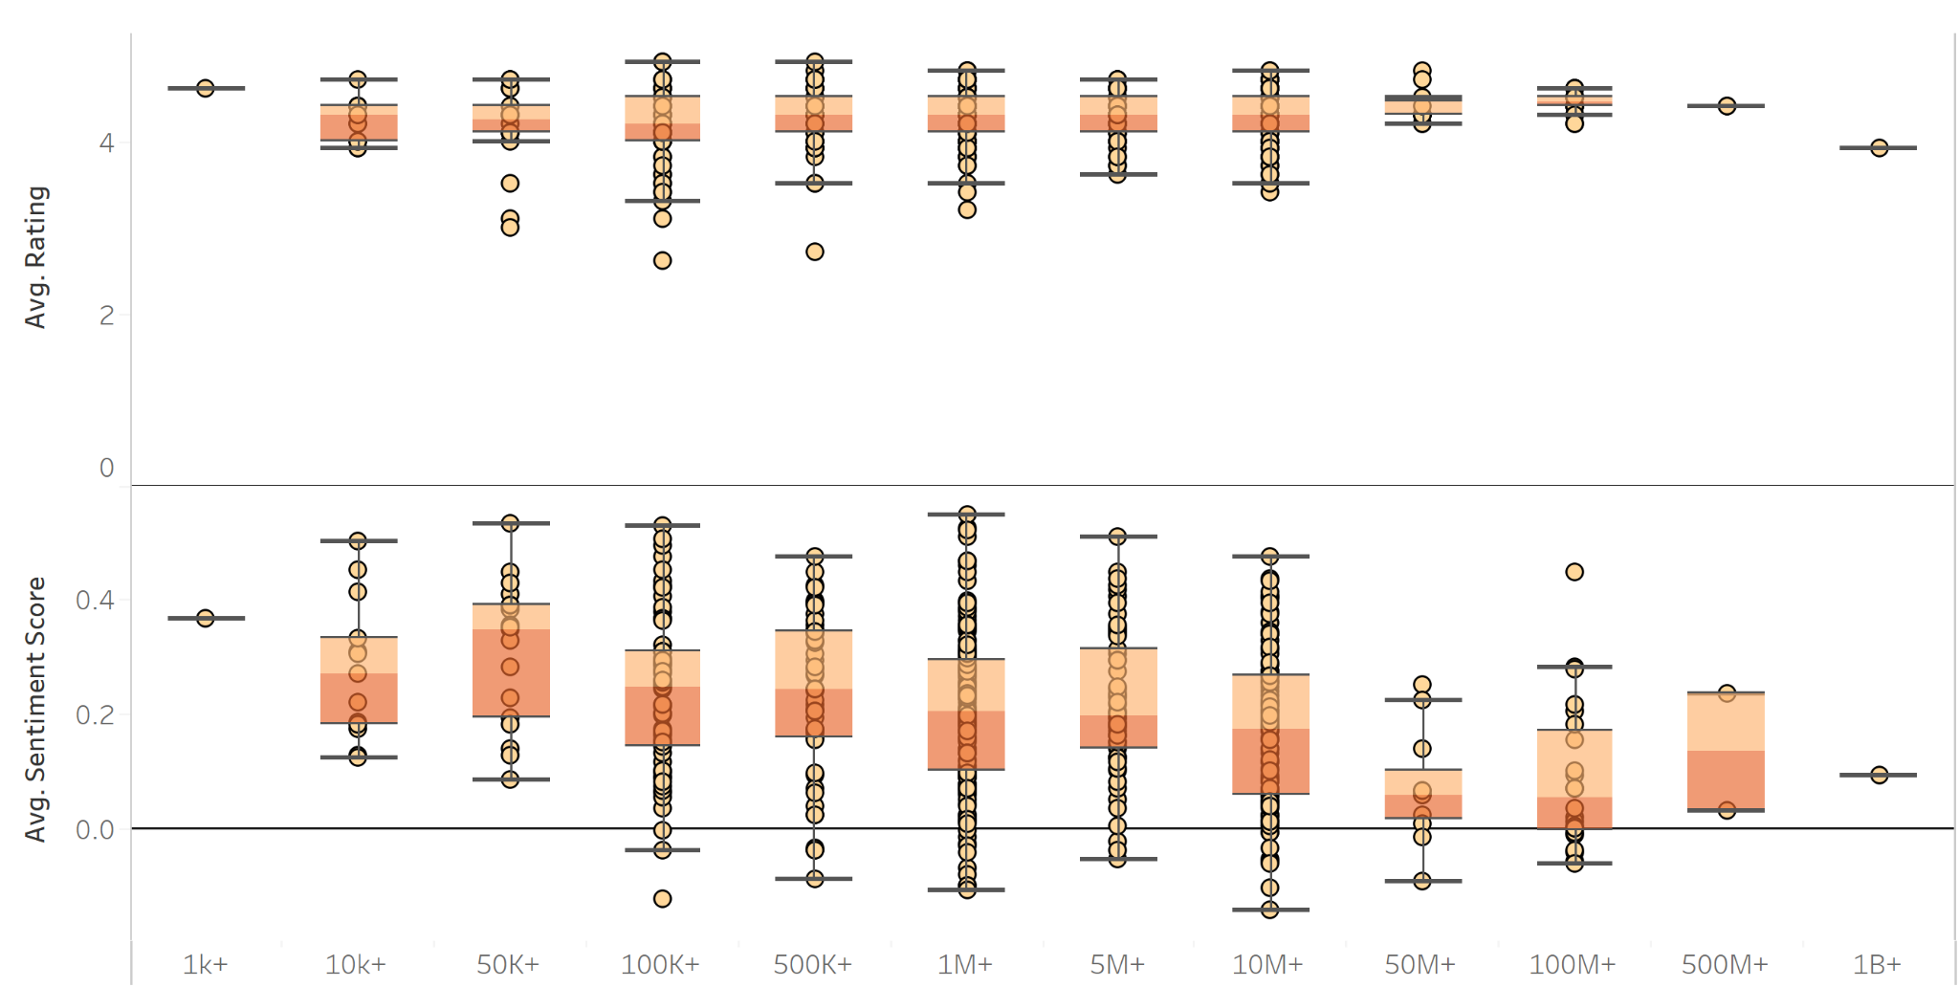
Distribution of Avg Rating and Avg Sentiment Score over Install Category
Dropbox
Google News
Candy Crush Saga

Slide 10
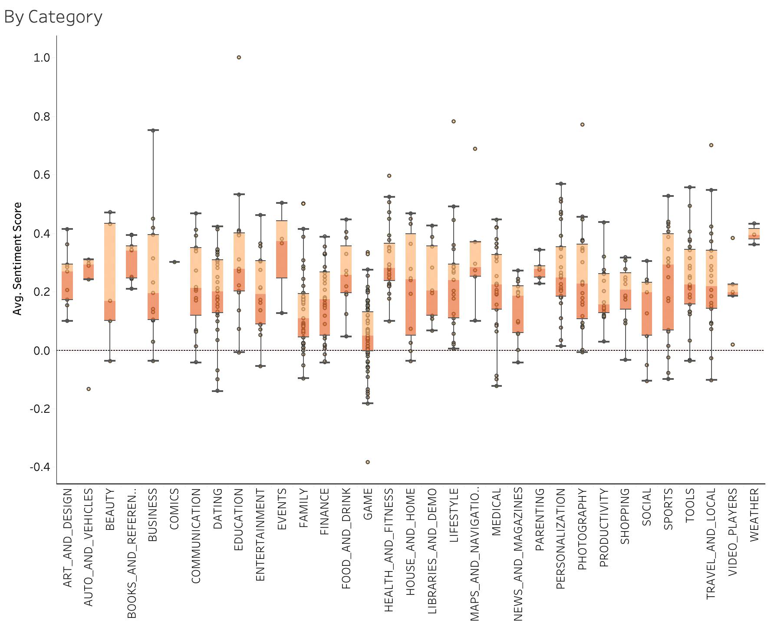
Avg Sentiment Score by Category distribution

Slide 11
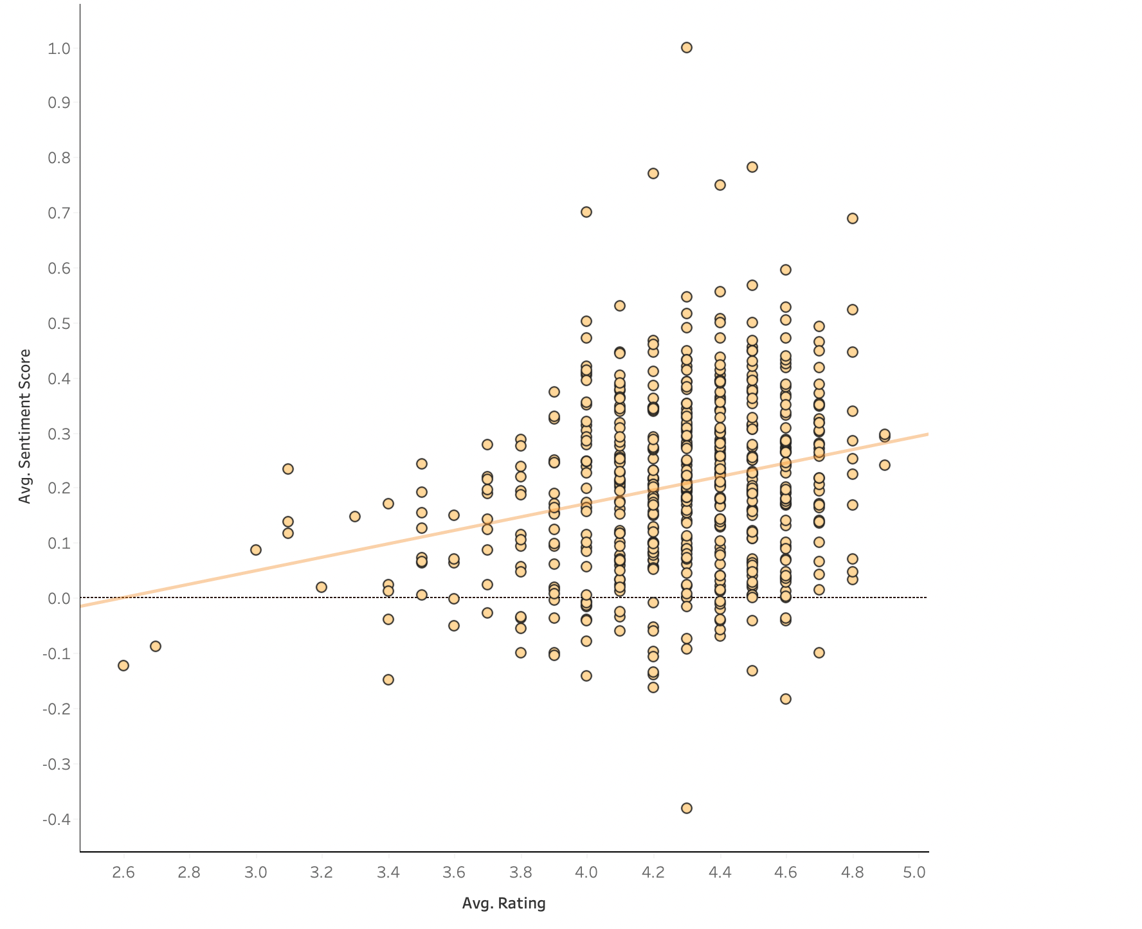
Avg Sentiment Score Vs Avg Rating

Slide 12
ANOVA App Category differences on #Install
App Category | sum_sq | df | F | PR(>F)
ART_AND_DESIGN | 5.22E+14 | 1 | 0.157293 | 0.691847
AUTO_AND_VEHICLES | 2.87E+14 | 1 | 0.086444 | 0.768882
BEAUTY | 4.28E+14 | 1 | 0.128982 | 0.719657
BOOKS_AND_REFERENCE | 4.73E+14 | 1 | 0.142303 | 0.706178
BUSINESS | 5.33E+14 | 1 | 0.160416 | 0.688962
COMMUNICATION | 5.37E+14 | 1 | 0.161625 | 0.687853
DATING | 1.93E+15 | 1 | 0.58207 | 0.445897
EDUCATION | 6.16E+14 | 1 | 0.185665 | 0.666754
ENTERTAINMENT | 7.54E+14 | 1 | 0.226956 | 0.634019
EVENTS | 3.54E+14 | 1 | 0.106692 | 0.744092
FAMILY | 8.78E+12 | 1 | 0.002644 | 0.959013
FINANCE | 1.60E+15 | 1 | 0.482947 | 0.487445
FOOD_AND_DRINK | 5.30E+14 | 1 | 0.15952 | 0.689786
GAME | 7.18E+16 | 1 | 21.630031 | 0.000004
HEALTH_AND_FITNESS | 1.22E+15 | 1 | 0.368009 | 0.544394
HOUSE_AND_HOME | 8.82E+14 | 1 | 0.265519 | 0.606604
LIBRARIES_AND_DEMO | 5.25E+14 | 1 | 0.158114 | 0.691086
App Category | sum_sq | df | F | PR(>F)
LIFESTYLE | 6.89E+14 | 1 | 0.207576 | 0.648891
MAPS_AND_NAVIGATION | 3.09E+14 | 1 | 0.093106 | 0.760405
MEDICAL | 1.88E+15 | 1 | 0.565351 | 0.452501
NEWS_AND_MAGAZINES | 7.19E+16 | 1 | 21.66776 | 0.000004
PARENTING | 4.02E+14 | 1 | 0.121119 | 0.727985
PERSONALIZATION | 2.07E+14 | 1 | 0.062407 | 0.802844
PHOTOGRAPHY | 2.82E+14 | 1 | 0.085068 | 0.770677
PRODUCTIVITY | 2.27E+16 | 1 | 6.8299 | 0.009261
SHOPPING | 1.41E+14 | 1 | 0.042563 | 0.836643
SOCIAL | 2.05E+14 | 1 | 0.061767 | 0.803837
SPORTS | 7.76E+14 | 1 | 0.233556 | 0.629132
TOOLS | 2.41E+14 | 1 | 0.072696 | 0.787573
TRAVEL_AND_LOCAL | 5.54E+14 | 1 | 0.166809 | 0.683155
VIDEO_PLAYERS | 5.09E+13 | 1 | 0.015314 | 0.901567
WEATHER | 1.62E+14 | 1 | 0.048693 | 0.825452
Residual | 1.51E+18 | 455 | NaN | NaN
Notes:
We looked at Installation rate by app category via 2-way ANOVA, and found that GAME and News and Magazine apps had significantly higher rates of installation in comparison to the other app categories.

Slide 13
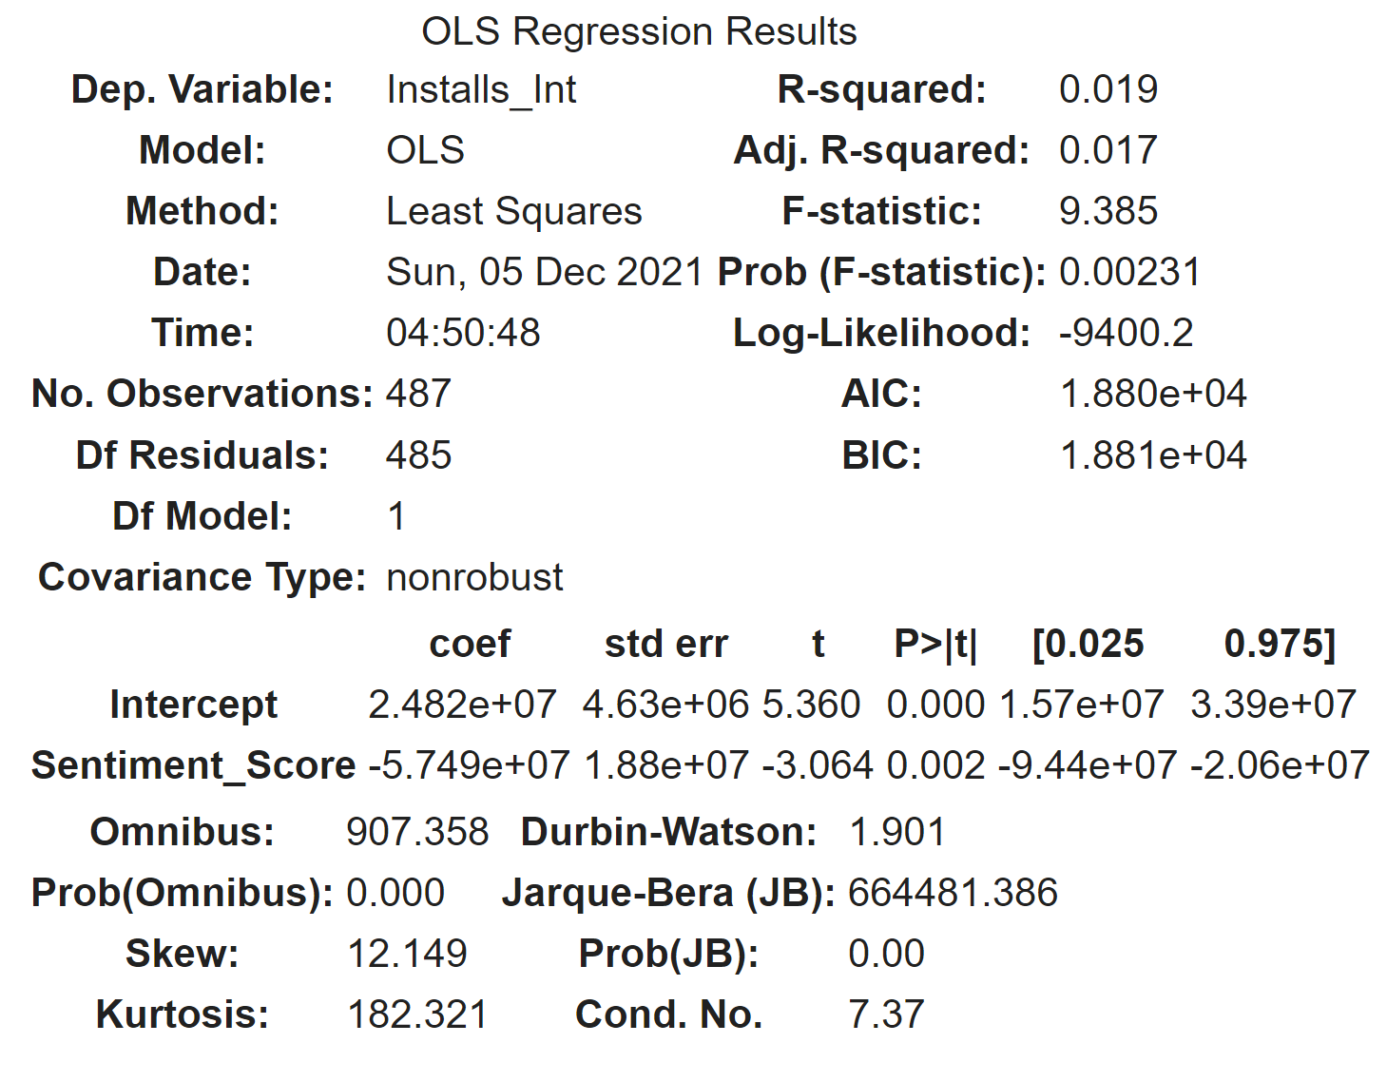
Installs = B₀ + B₁Sentiment
H0: B1 is not statistically
significant and sentiment score does not impact the number of installs
HA: B1 is statistically significant and sentiment score has an impact on the number of installs

Slide 14
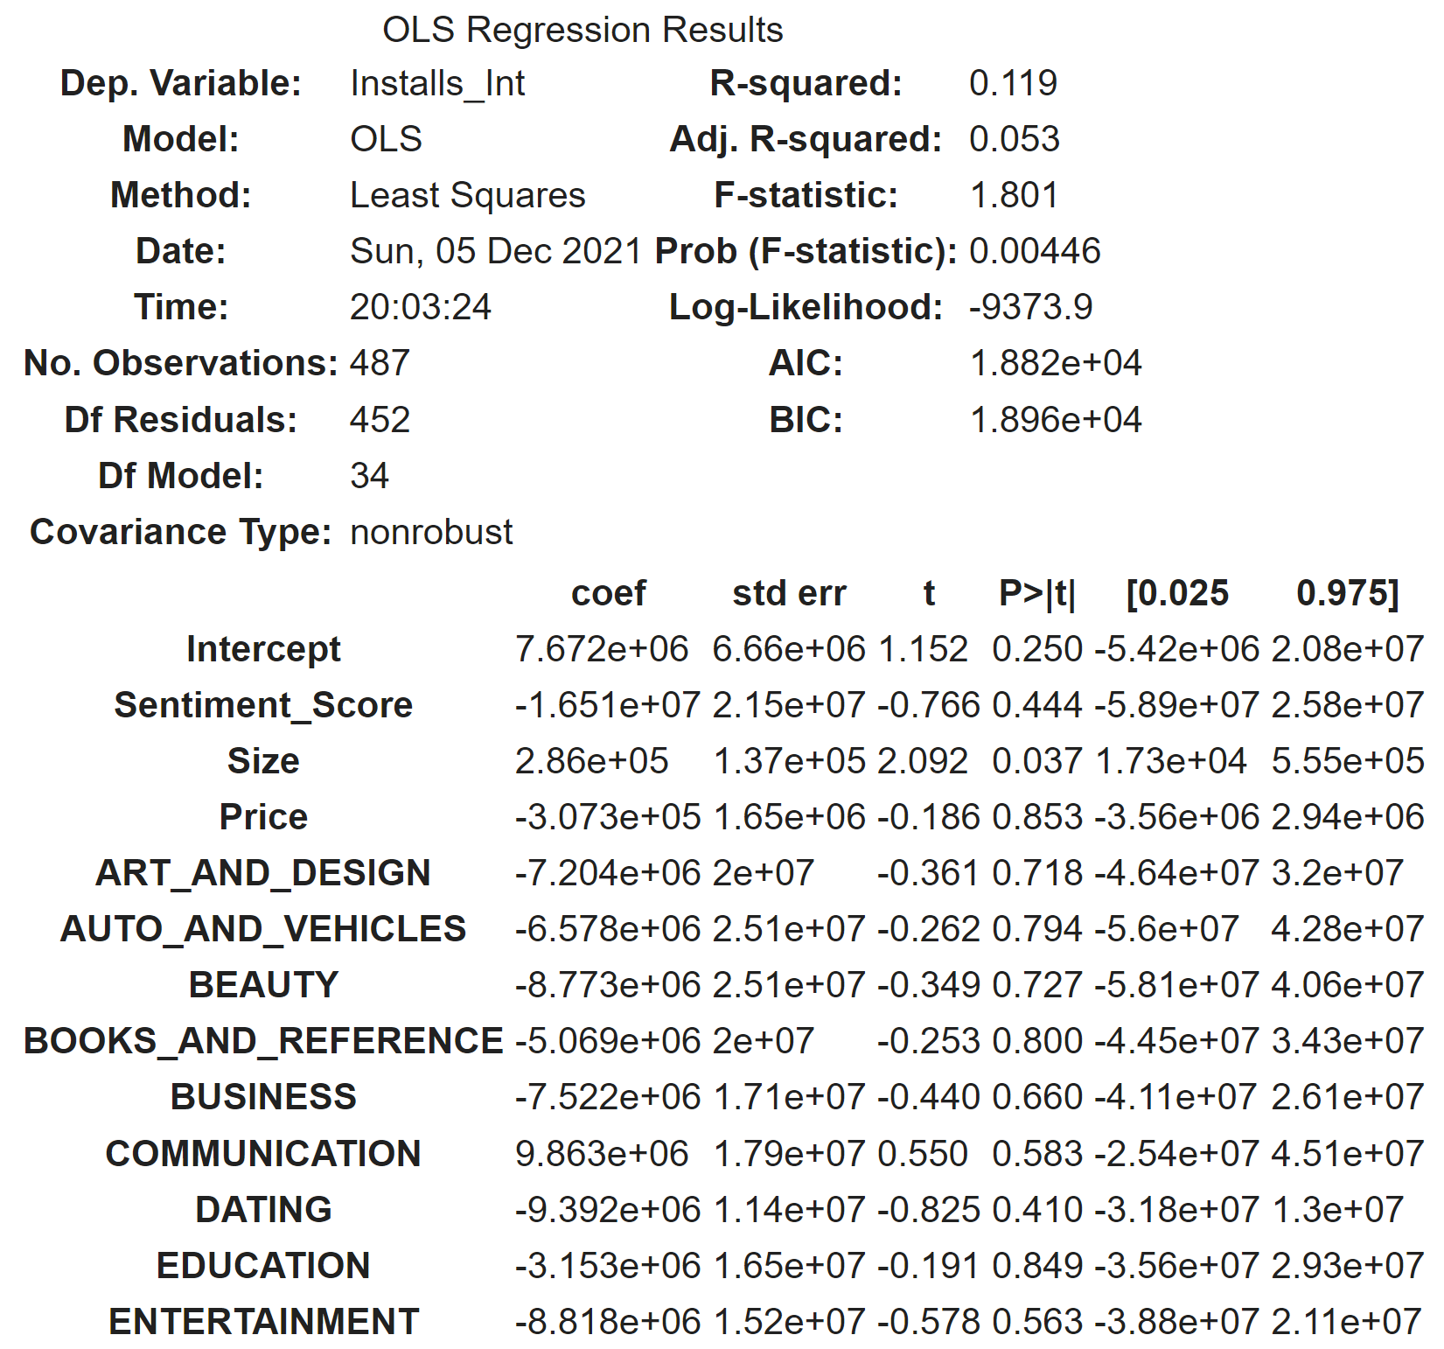
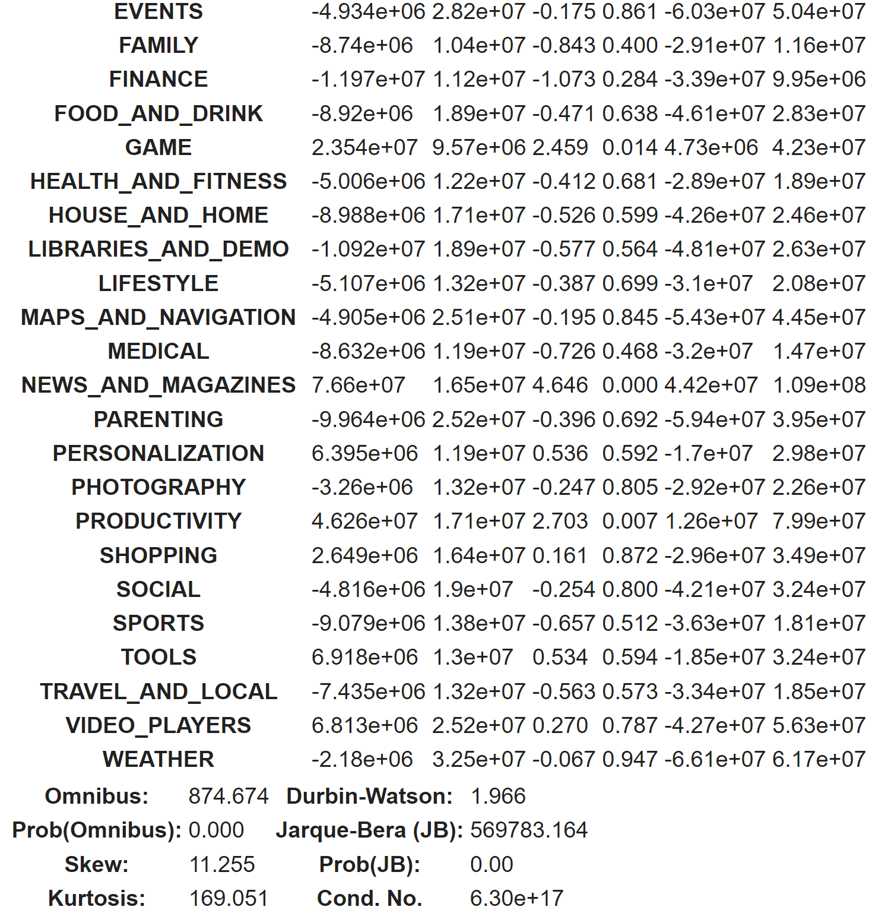
Installs = B₀ + B₁Sentiment + B₂Size + B₃Price + ∑B_{n}Category_{n}
We added in some more variables, including dummy variables for the categories, to see if the influence of other variables.

Slide 15
Results
Games , Productivity and News and Magazine apps have significantly higher Install rates
2-way ANOVA, alpha 0.05 Google News & Candy-Crush
Increase of sentiment score → decrease in # app installs
0.1 increase in sentiment score leads to 5.75M decrease in installs (p=0.002)
Increase of sentiment score controlling for app size, price, and category is not significant
0.1 increase in sentiment score leads to 1.65M decrease in installs (p=0.444)

Slide 16
Business Recommendations
Lack of Reliability as a Success Metric
01
Do not rely on review sentiment of apps as an indicator of success
Use Apps with Negative Sentiment for Product Improvement
02
Don’t use sentiment scores as an indicator of app future success, but reviews with negative sentiment can provide valuable insights on how to improve your app.
Higher Utility Apps Will Have More Installs
03
Regardless of sentiment score, if someone needs to use an app, they will use it, regardless of how they may feel about the interface.

Slide 17
Limitations
01
02
03
04
Imbalanced Sentiment in Reviews
The sentiment shown in these is mainly positive. We are unsure of if this is characteristic of apps overall, or just because of the sample selected for this dataset.
Data on # installs should be represented on continuous scale
The data gives us number of installs as a categorical, numerical variable. The analysis would be much more accurate if we were able to see the exact number of installs for each app in the dataset, rather than the numerical category that it falls in to.
Few apps in high in highest installation rate categories
There are only 2 apps in the 500M+ installs category and only 1 app in the 1B+ installs category. We are unable to draw strong conclusions the effect of sentiment score on these categories without larger samples.
Only one app in lowest installation rate category
The 1k+ installation category only has 1 app in it, making it difficult to draw conclusions about the impact of sentiment score when only one app is representing the entire category.

Slide 18
Thank You

